Slide 1
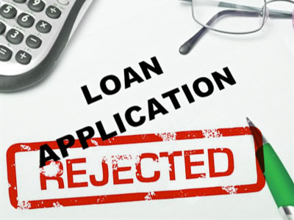
Micro Credit Defaulter Project
Submitted by:-
Bhavesh Kharve
Internship Team 16

Slide 2
Overview
A Microfinance Institution (MFI) is an organization that offers financial services to low income populations. MFS becomes very useful when targeting especially the unbanked poor families living in remote areas with not much sources of income. The Microfinance services (MFS) provided by MFI are Group Loans, Agricultural Loans, Individual Business Loans and so on.
Many microfinance institutions (MFI), experts and donors are supporting the idea of using mobile financial services (MFS) which they feel are more convenient and efficient, and cost saving, than the traditional high-touch model used since long for the purpose of delivering microfinance services. Though, the MFI industry is primarily focusing on low income families and are very useful in such areas, the implementation of MFS has been uneven with both significant challenges and successes. Today, microfinance is widely accepted as a poverty-reduction tool, representing $70 billion in outstanding loans and a global outreach of 200 million clients.
We are working with one such client that is in Telecom Industry. They are a fixed wireless telecommunications network provider. They have launched various products and have developed its business and organization based on the budget operator model, offering better products at Lower Prices to all value conscious customers through a strategy of disruptive innovation that focuses on the subscriber.
They understand the importance of communication and how it affects a person’s life, thus, focusing on providing their services and products to low income families and poor customers that can help them in the need of hour.

Slide 3
Problem Statement
Telecom companies are collaborating with an MFI to provide micro-credit on mobile balances to be paid back in 5 days. The Consumer is believed to be defaulter if he deviates from the path of paying back the loaned amount within the time duration of 5 days. For the loan amount of 5 (in Indonesian Rupiah), payback amount should be 6 (in Indonesian Rupiah), while, for the loan amount of 10 (in Indonesian Rupiah), the payback amount should be 12 (in Indonesian Rupiah). The sample data is provided to us from our client database. It is hereby given to you for this exercise. In order to improve the selection of customers for the credit, the client wants some predictions that could help them in further investment and improvement in selection of customers.
Mission:
Build a model which can be used to predict in terms of a probability for each loan transaction, whether the customer will be paying back the loaned amount within 5 days of insurance of loan. In this case, Label ‘1’ indicates that the loan has been payed i.e. Non- defaulter, while, Label ‘0’ indicates that the loan has not been payed i.e. defaulter.

Slide 4
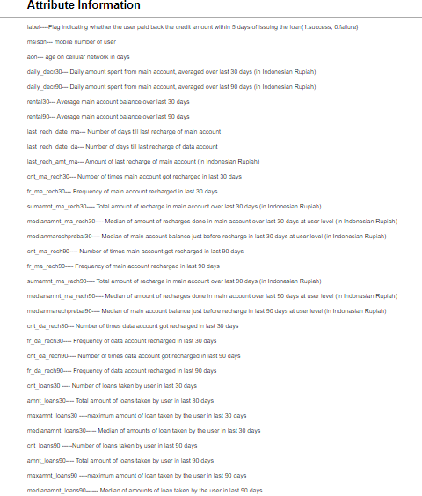
Attribute Information

Slide 5
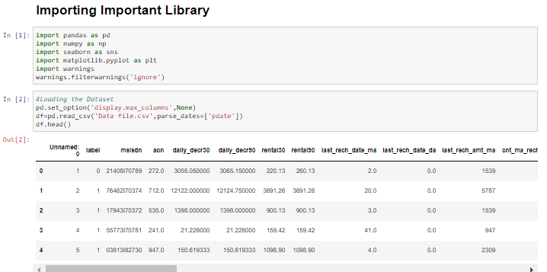
Loading Dataset

Slide 6
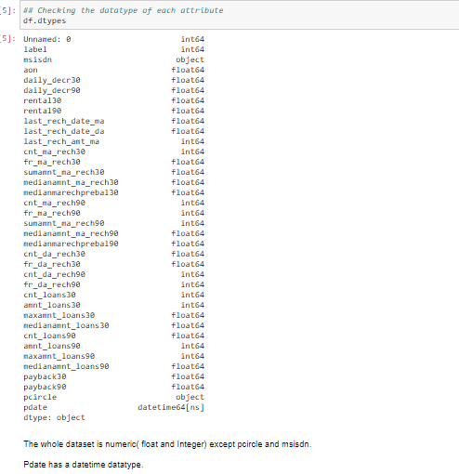
Checking datatype

Slide 7
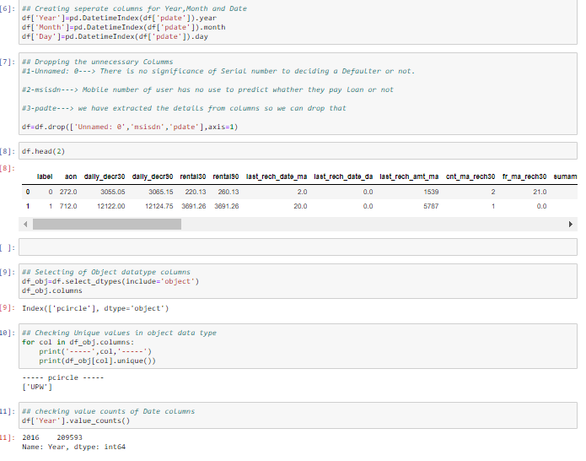
Feature Extraction and Dropping columns
We have dropped
1-unnamed:0
2-msidn
3-pdate

Slide 8
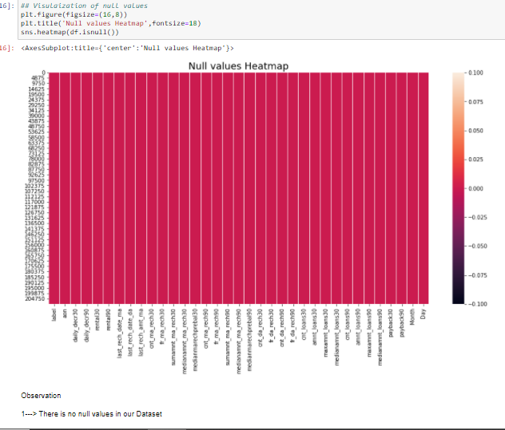
Null Values
There is no null values present on our dataset.
We have 35 columns.

Slide 9
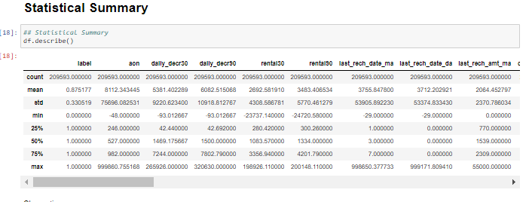
Statistical Summary
Observation
1-Most attribute are either left or right skewed.
2-Mean and higher than median in most of attribute.
3-Miminum value is either zero or -ve in features except Month and Day.
4- The Range (Min- Max) is very much higher in most of attributes.
5- In most of attribute, the difference between 3rd quantile (75%) and max values is very high.
6- Most of attributes consist of outliers.

Slide 10
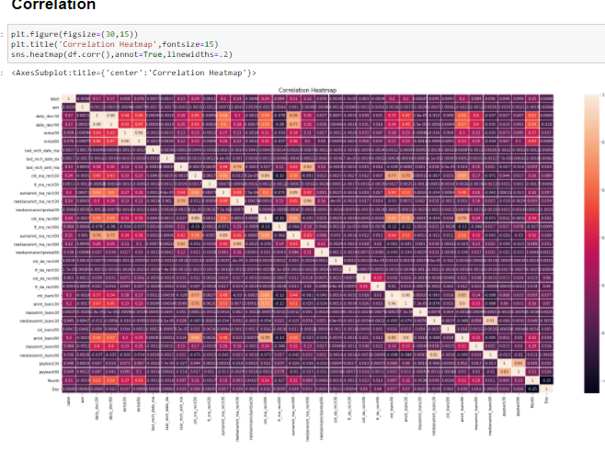
Correlation Heat Map

Slide 11
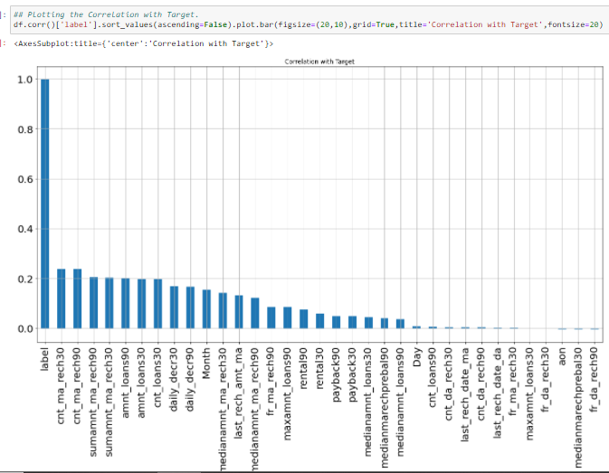
Correlation with target Attribute
Observation:
1- Overall dataset have neither very strong positive nor negative correlation.
2- Features like age on age of network (aon),fr_da_rech30,medianmarechprebal30,fr_da_rech90 are negatively correlated but we won't drop these because these are important features.

Slide 12
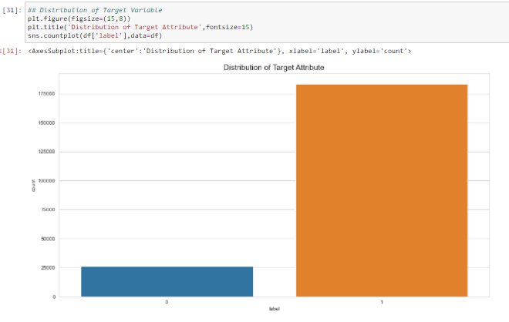
Distribution of Target
Target variable Is imbalance.

Slide 13
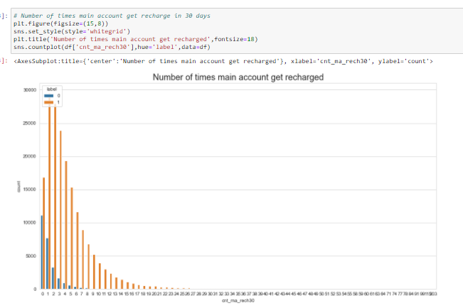
Data Visualization
Observation:
1- This graph shows that the most people recharge there phone one time in months.
2- People who recharge there phone 3-5 times in months have also very less tendency be a defaulter.
3-People who don't recharge their phone in months have very high tendency to be a defaulter.

Slide 14
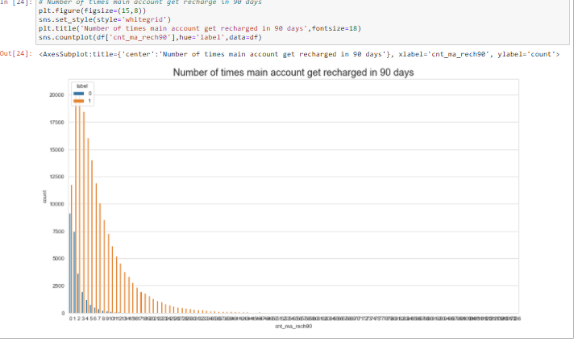
Data Visualization
1- People who don't recharge there phone in 90 days have higher tendency to take micro loan and to be an defaulter by not paying within 5 days.
2-The trend(Taking loan and being defaulter) goes down as number of time account recharge increase in 90 days.

Slide 15
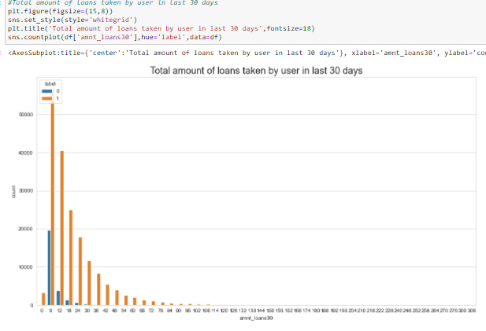
Data Visualization
Mostly user recharge took loan of 6(in Indonesian Rupiah).
2-As of domain knowledge, if people recharge then 1st he have to pay the loan then again user get chance to take another loan.
3-12,18,24(in Indonesian Rupiah) could be taken by those person who payback the multiple loan within a months and took another.
4- Gradual drop in loan rupee after 12 Indonesian Rupiah, People are also have tendency to pay back.

Slide 16
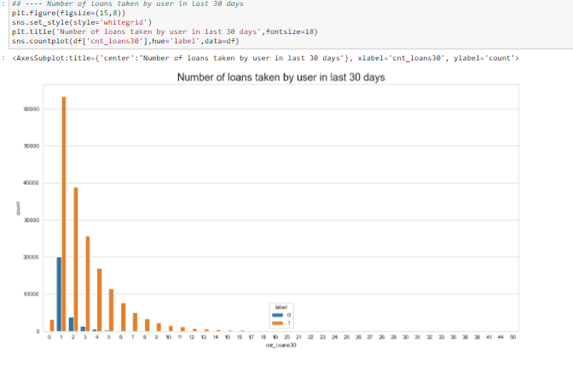
Data Visualization
Observation:
1-The trends shows, when number of loan taken by user decreases, it's tendency to be a defaulter is also goes down.
2-There is higher risk to to grant micro loan to a user who take loan once in month.

Slide 17
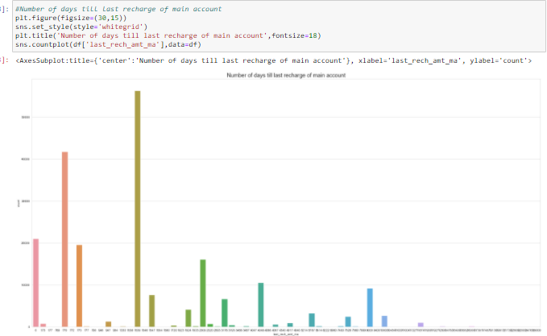
Data Visualization

Slide 18
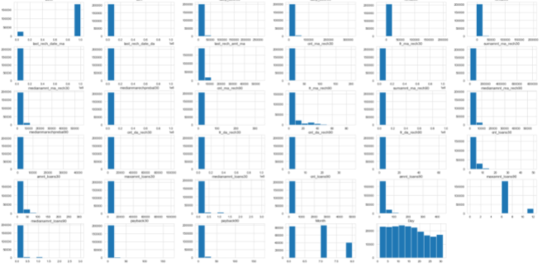
Distribution Histogram
1- Most attribute are highly right skewed.

Slide 19
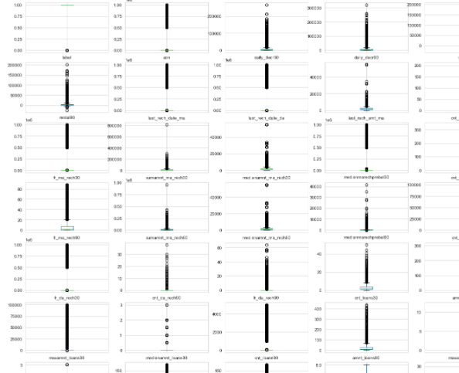
Box plot for Outliers Checking
Observation
1-- The above distribution plot shows that mostly features are right skewed.
2-- In boxplot it is clearly visible that there are very high number of outliers are present in our datatset.

Slide 20
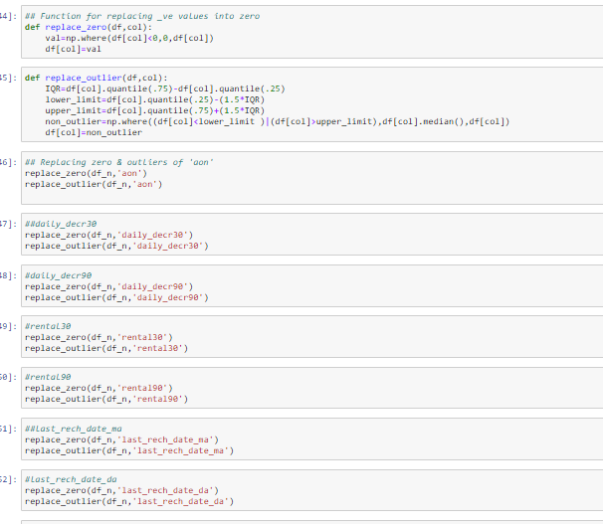
Replacing Outliers and Erroneous Data
Hear we found so many -ve values and too much high values .
We will replace -ve values with zero values because amount or Days can't be in too much negative.
we will replace all od them by zero
We will replace outliers with median values.

Slide 21
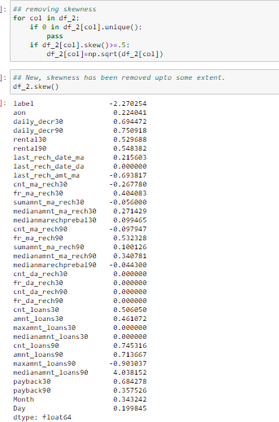
Skewness & Treatment

Slide 22
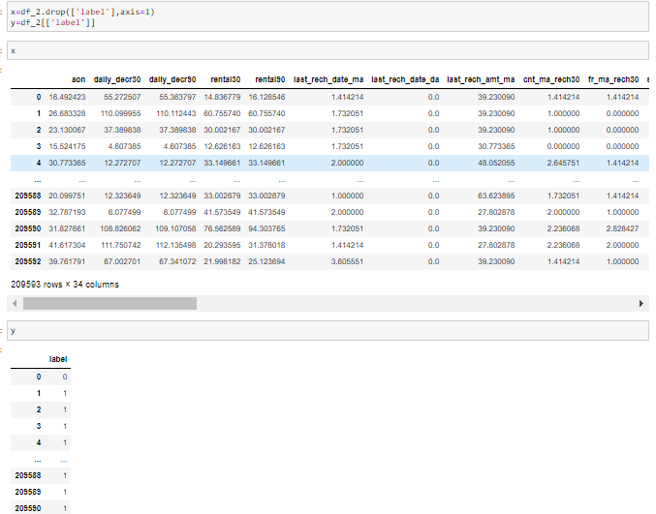
Splitting data into input and output

Slide 23
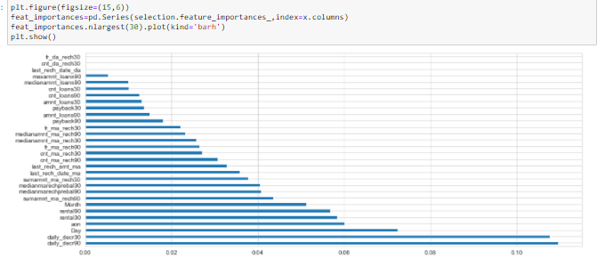
Feature Importance
from sklearn.preprocessing import StandardScaler
ss=StandardScaler()
df_scaler=ss.fit_transform(x)
x=pd.DataFrame(df_scaler)
x.head()

Slide 24
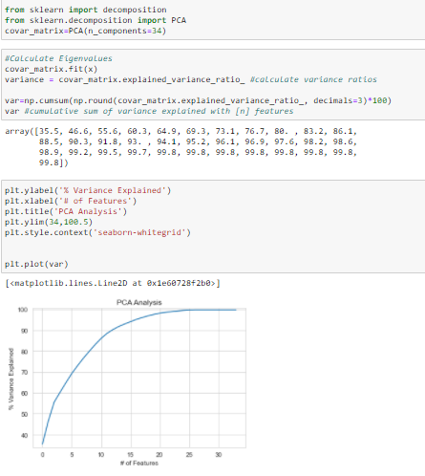
PCA
Based on the plot above it's clear we should pick 20 features at 99% variance

Slide 25
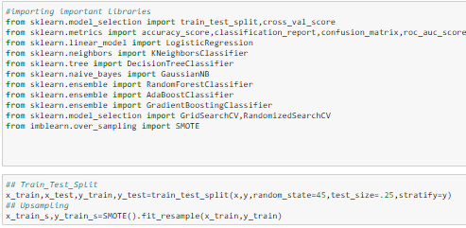
Importing Machine Learning Library
Train_test_split done
Up sampling done

Slide 26
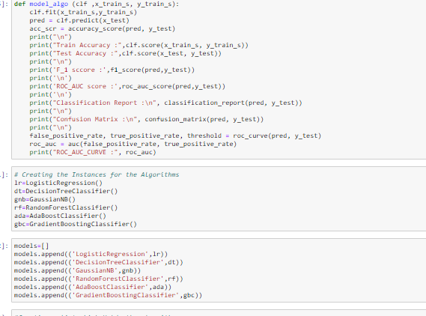
Creating Function for Machine learning model

Slide 27
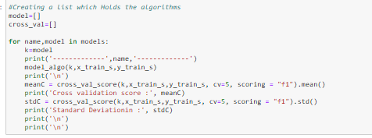
Providing data to our function

Slide 28
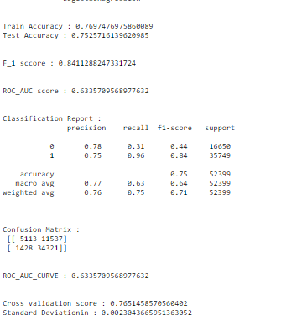
Logistic Regression Result
Train accuracy-76.74
Test accuracy-75.25
F1_score-84.11
Cross validation score-63.35

Slide 29
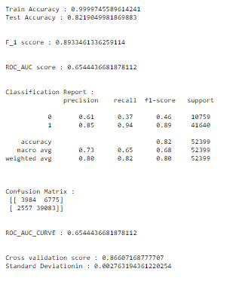
Decision Tree
Train Accuracy-99.97
Test Accuracy-82.19
f_1 score-89.33
Cross validation score-86.60

Slide 30
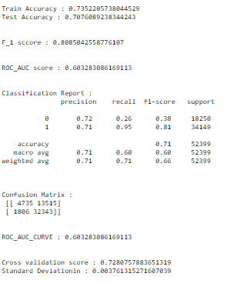
Naïve Bayes
Train Accuracy-73.52
Test Accuracy-70.76
F_1 score-80.85
Cross Validation score-60.32

Slide 31
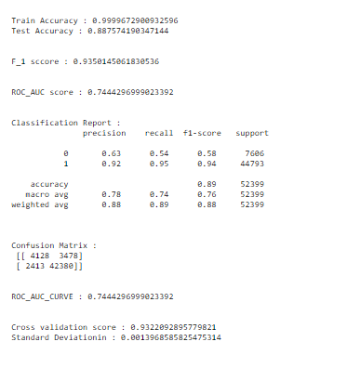
Random Forest Classifier
Train Accuracy-99.99
Test Accuracy—88.75
F_1 score=93.50
Cross val Score=93.22

Slide 32
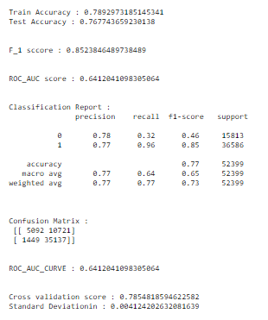
AdaBoost Classifier
Train Accuracy-78.29
Test Accuracy-76.77
F_1 score-85.23
Corss validation-64.12

Slide 33
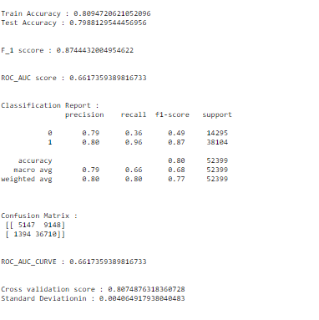
Gradient Boosting Classifier
Train Accuracy—80.94
Test Accuracy-79.88
F_1 score-87.44
Cross Val-80.47

Slide 34
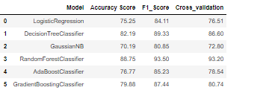
Result Comparison
1- Based on all there above results it shows that Random Forest Classifier gives us Test Accuracy : 0.887574190347144
F_1 score : 0.9350145061830536 and cross validation score is also
Cross validation score : 0.9322092895779821 with least
standard deviation(Standard Deviation in : 0.0013968585825475314).

Slide 35
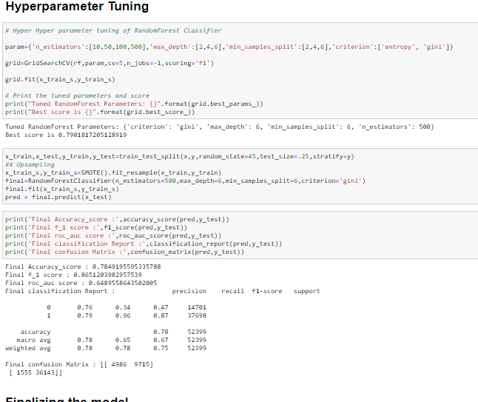
Hyperparameter Tuning of Random Forest
Best Parameters;
Criterion– gini
Max-depth-6
Min_samples_split-6
N_estimators-500
Accuracy score-78.49
F_1 score=86.51
Roc_auc score-64.89

Slide 36
Selecting our Model
We can clearly see that Random forest classifier gives us the highest Accuracy score and F-1 score among all the models.
We can also conclude from the cross validation score that there is a minimum standard deviation for our cross val score.
This shows that our Random forest Model is not overfit as we get similar (approx.) result by cross validation score
On basis of that we did hyperparameter tuning of Random Forest Classifier model but we get less accuracy & f_1 score on tuning parameters.
We get a very good accuracy and f_1 score on default parameters, so we further save our default Random forest Model.

Slide 37

Saving our model

Slide 38
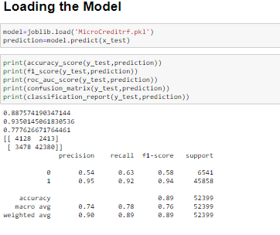
Loading our Model

Slide 39
Thanks

